Slide 1

Special Methods in Python
Welcome to the presentation on special methods in Python!
Discover the hidden powers of magic methods and how they enhance the functionality of your Python classes.

Slide 2
What are Special methods?
Special methods, also known as magic methods or Dunder methods (short for "double underscore"), provide a way to define the behavior of built-in operations in Python.
They are always surrounded by double underscores, such as init, str, or add.
__init__: Initializes an object when it is created.
__str__: Returns a string representation of an object.
__repr__: Returns a string representation of an object for debugging.
__add__: Implements addition (+).
__eq__: Compares two objects for equality.
__len__: Returns the length of an object.
__getitem__:Allows object indexing using square brackets.
__enter__:Defines the actions when entering a context.
__exit__:Defines the actions when exiting a context.
__getattr__(self, name): Retrieves inaccessible attributes.
__setattr__(self, name, value): Sets the value of an attribute.
__delattr__(self, name): Deletes an attribute.
__iter__: Returns an iterator object for iteration.
__next__: Returns the next value from an iterator.

Slide 3
Special methods, also known as magic methods or dunder methods, are predefined methods in Python that allow you to define the behavior of your custom classes.
Special methods are recognizable by their double underscore naming convention, such as __init__ or __str__.
Special methods are automatically called by the Python interpreter under specific circumstances.
Special methods provide powerful customization options and integrate well with Python's built-in features and syntax.

Slide 4
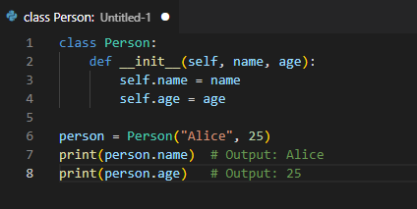
The Power of Initialization: init
The init method allows you to initialize the attributes of an object when it is created.
It is automatically called when an object is instantiated.

Slide 5
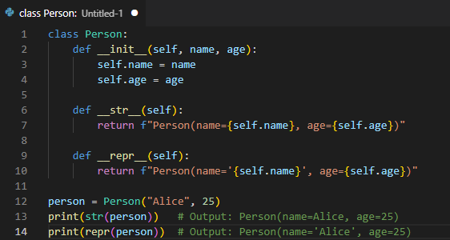
String Representation: str and repr
str method returns a string representation of the object, which is useful for end-users.
repr method returns a string representation of the object that is unambiguous and used for debugging purposes.

Slide 6
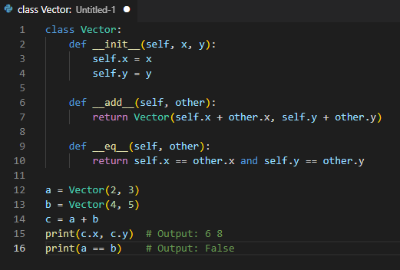
Operator Overloading: Arithmetic and Comparison
Python allows you to define the behavior of operators such as +, -, *, /, ==, >, <, etc.
Methods like add, sub, mul, truediv, eq, gt, lt, etc., enable operator overloading.

Slide 7
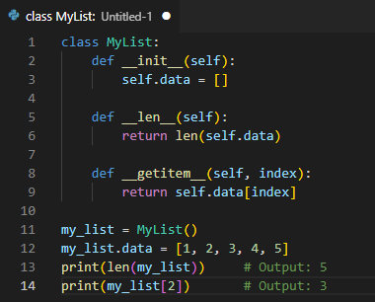
Container Operations: len and getitem
len allows you to define the length of an object.
getitem enables accessing elements of an object using square brackets.

Slide 8
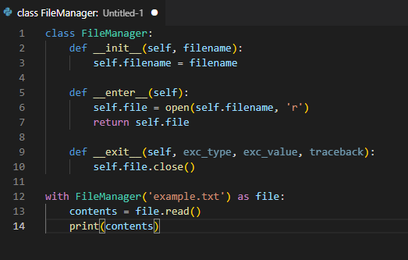
Context Management: enter and exit
enter and exit are used for implementing context managers.
They allow you to define actions to be taken before and after the execution of a block of code.

Slide 9
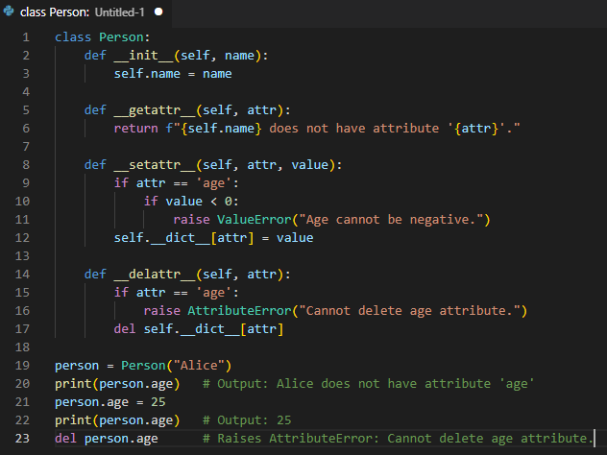
Customizing Attribute Access: getattr, setattr, and delattr
getattr handles the retrieval of non-existent attributes.
setattr deals with attribute assignment.
delattr handles attribute deletion.

Slide 10
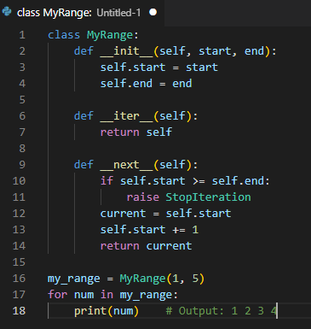
Special Methods for Iteration: iter and next
iter allows an object to be iterable, while next defines the behavior for obtaining the next item in the iteration.

Slide 11
Conclusion
Special methods in Python provide a way to customize the behavior of built-in operations.
They unlock the power of magic, enabling you to create more expressive and efficient classes.
Embrace the magic methods and take your Python programming to the next level!

Slide 12
Thank you!
Q&A

